Slide 1
Quantitative Research Methods
March 13, 2023
Professor Patrick Rebuschat
p.rebuschat@lancaster.ac.uk
Notes:
Section title slide.

Slide 2
Reminder from last week

Slide 3
What is a confidence interval?
Confidence interval [M – MOE, M + MOE]
A range of values that we are 95% confident contains the population parameter.
The values within the CI are plausible for the population parameter being estimated.
The width of the CI tells us how precise our point estimate (M) is.

Slide 4
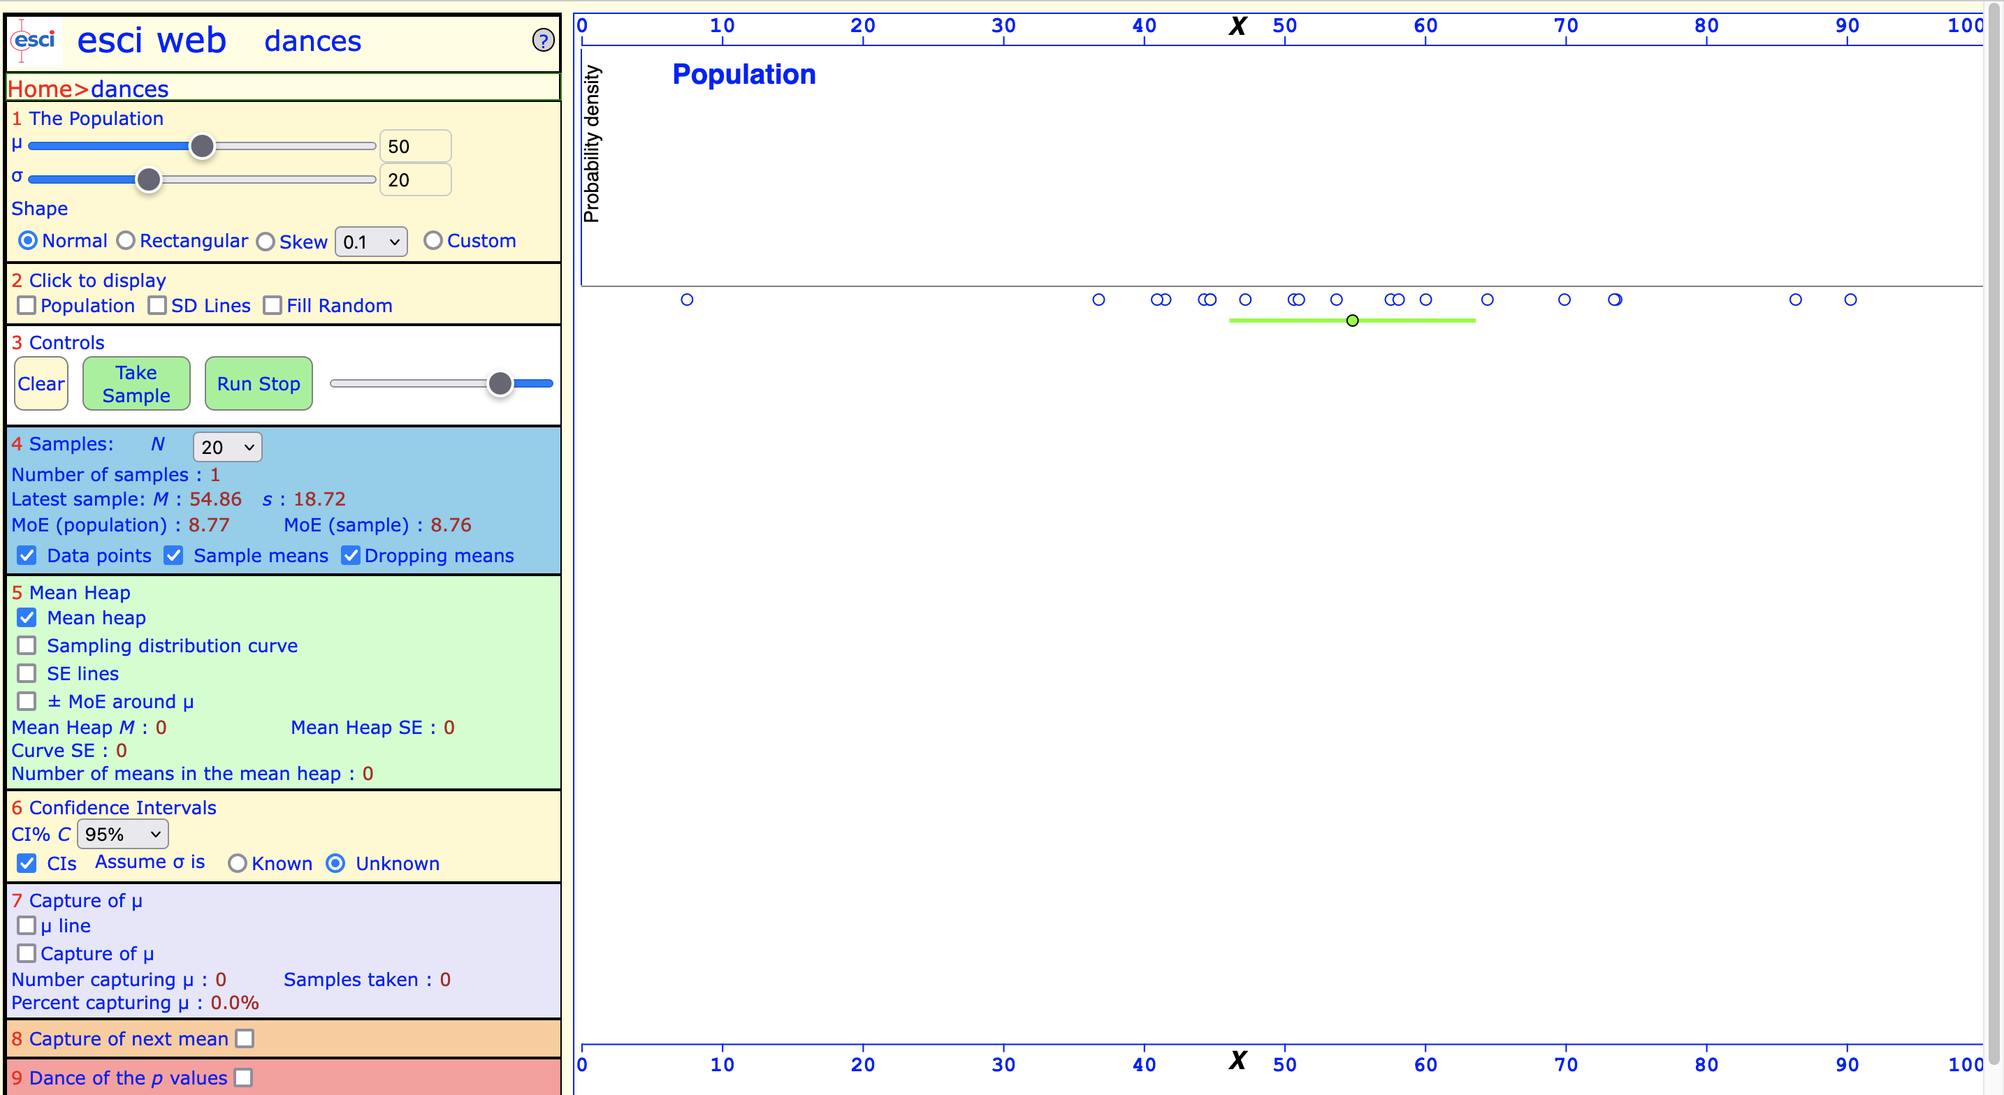
Confidence interval for one sample
In 36 out of 37 cases (97%)!
Confidence interval:
A range of values that we are 95% confident contains the population parameter.
We usually report 95% confidence level (but you can increase or decrease).
👉
👈

Slide 5
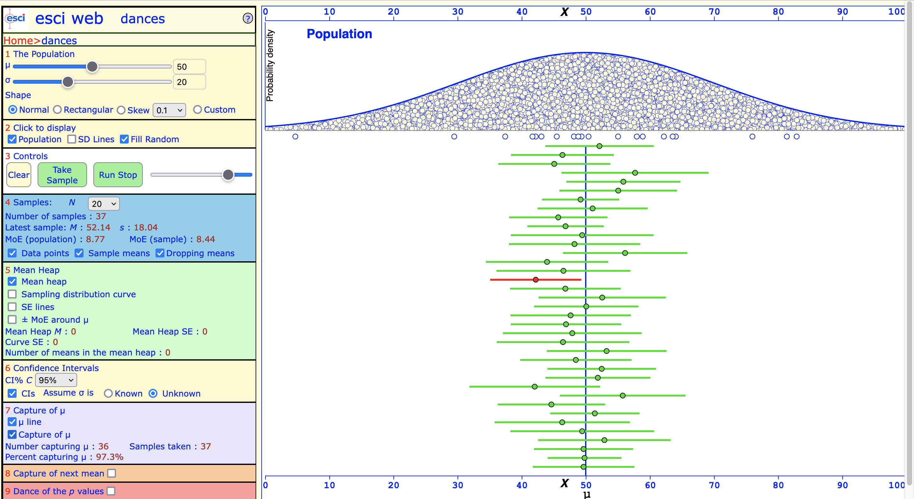
How often does the CI include the population parameter μ?
Only one CI did not include the population parameter!
In 36 out of 37 cases (97%)!
👉

Slide 6
Effect sizes
“Any of various measures of the magnitude or meaningfulness of a relationship between two variables. (…)” (APA Dictionary of Psychology, 2023)
Effect sizes should be the main focus of interpretation because they are the best information we have about the population.
Notes:
Effect sizes are interpreted as indicating the practical significance of a research finding.” (APA Dictionary of Psychology, 2023)

Slide 7
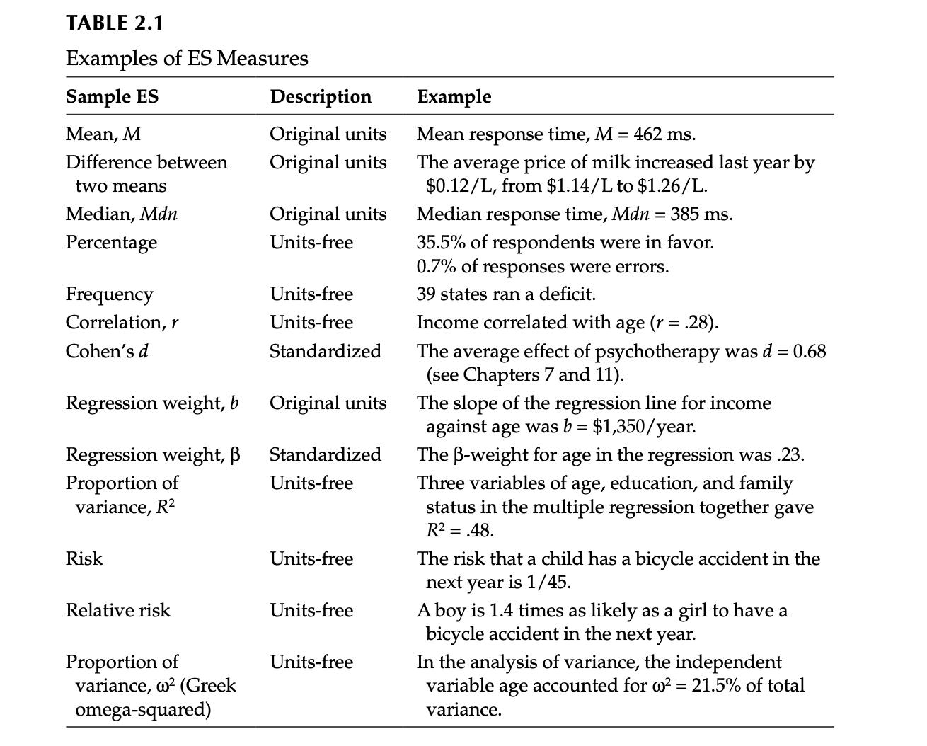
Effect sizes come in many shapes or forms.
Raw vs. standardized effect sizes
Example:
M_{diff} = 32.25
Cohen’s d = 1.96
👉

Slide 8
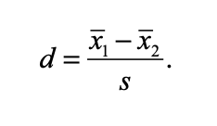
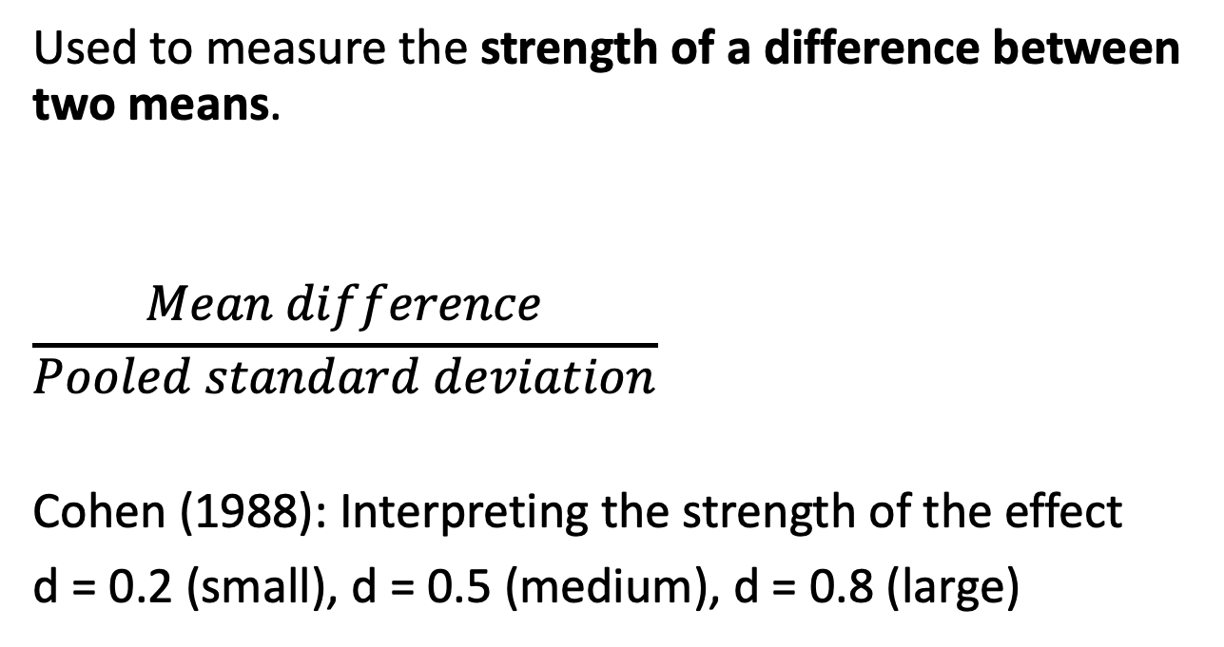
Standardized effect sizes: Cohen’s d
Used to measure the strength of a difference between two means.
$$\frac{Mean difference}{Pooled standard deviation}$$
Cohen (1988): Interpreting the strength of the effect
d = 0.2 (small), d = 0.5 (medium), d = 0.8 (large)

Slide 9
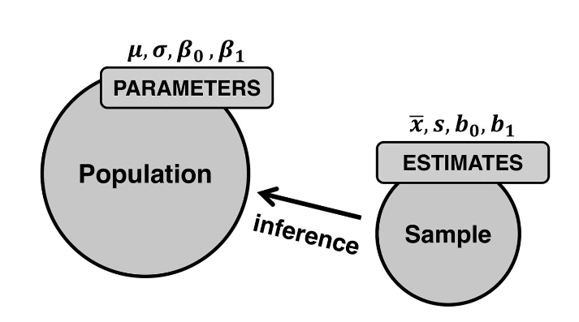
Null hypothesis significance testing (NHST)
The most widely used approach for statistical inference in the sciences.
But: Controversial as often used inappropriately.
Winter (2019)

Slide 10
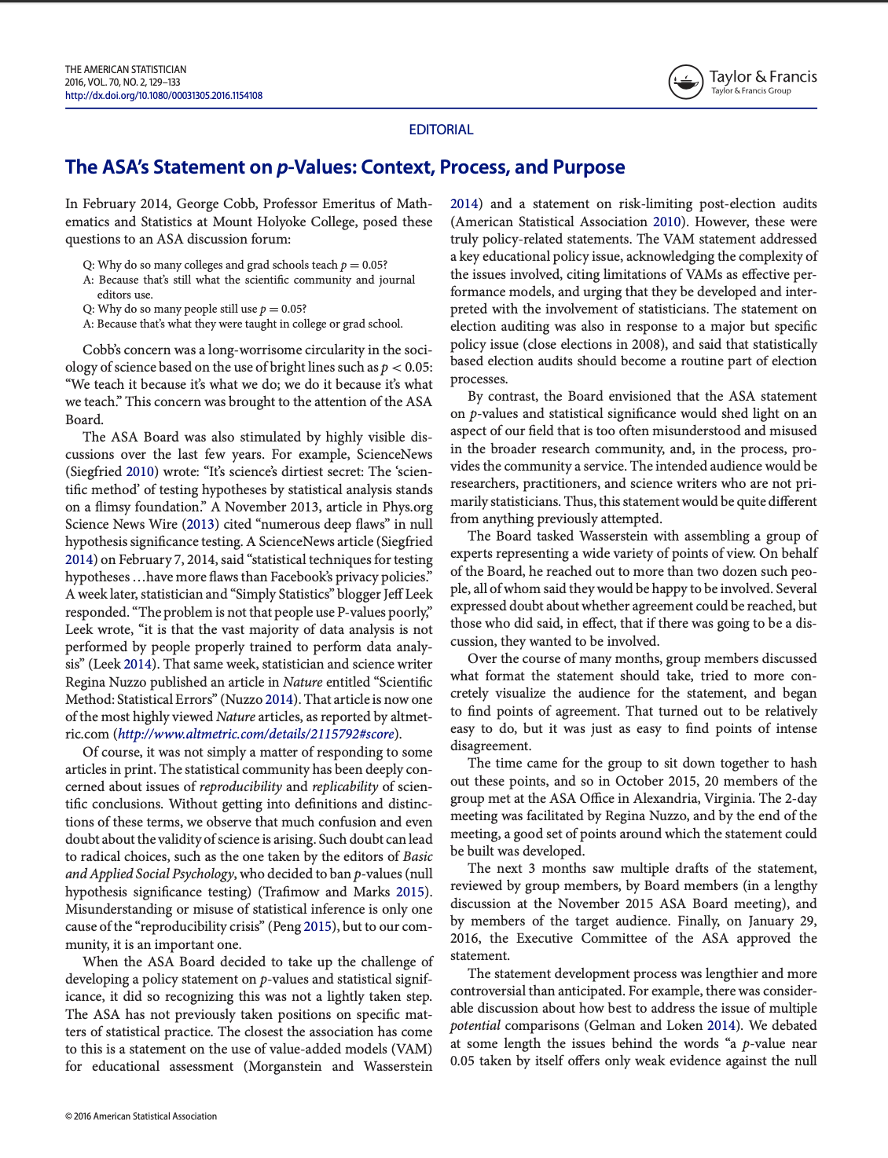
NHST statistics often misused or misunderstood
“Mindless statistics” (Gigerenzer, 2004)
ASA published the “ASA Statement on Statistical Significance and P-Values” (2017) to address the situation.
Many statisticians and other scientists have called for journals to stop publishing p-values.
Notes:
For discussion: Cumming (2012, 2014), Morey, Hoekstra, Rouder, Lee, & Wagenmakers (2016), Vasishth & Gelman (2017), etc.
For discussion, see Gigerenzer (2018), Dienes (2008), Perezgonzalez (2015), Szucs & Ioannidis (2017)

Slide 11
Classic steps in NSHT
Step 1: State the null hypothesis: H₀ μ1 = μ2
Step 2: Choose a significance level (.05)
Step 3: Select and apply the statistical test
Step 4: Calculate a p-value
Step 5: Report the results

Slide 12
Step 3: Select and apply the statistical test
Once the null hypothesis has been stated for the population, we look at our sample to measure how (in)compatible the actual data is with this initial assumption.
That is, when engaging in NHST, we measure the incompatibility of the data with the null hypothesis.
To do this, we select and apply an appropriate “significance test” (Fisher, 1925).
Notes:
“Critical tests of this kind may be called tests of significance, and when such tests are available we may discover whether a second sample is or is not significantly different from the first.” (Fisher, 1925, p. 43)

Slide 13
Selection of the significance test will depend on :
What kind of data is involved: continuous or categorical?
How many groups are being compared?
Are the group variances approximately equal?
Are the groups independent of one another?

Slide 14
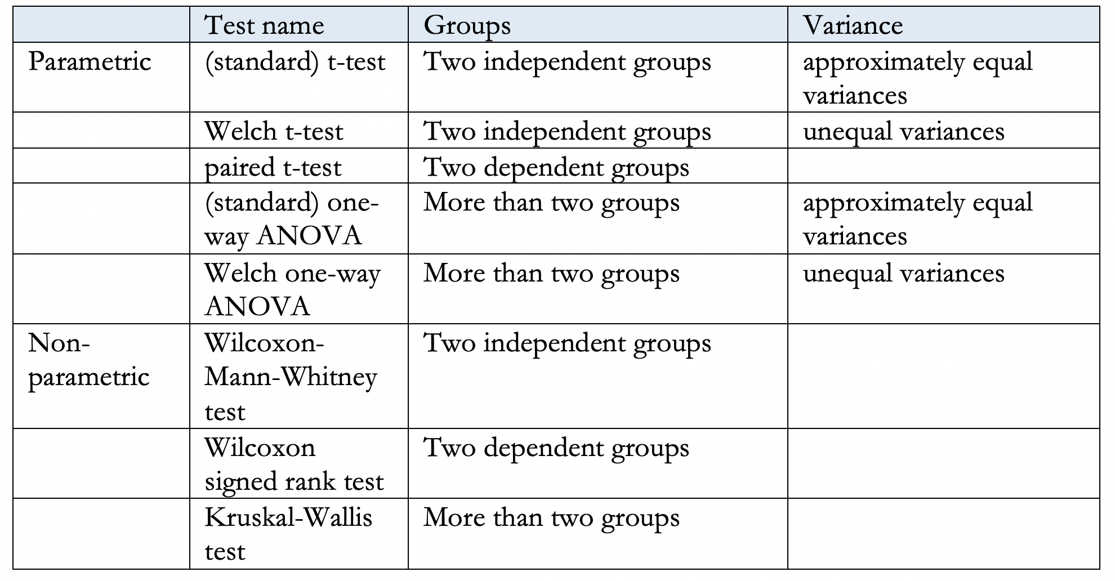
For example

Slide 15
Step 4: Calculate a p-value
What is the p-value?
A statistically significant result is simply one that would rarely be observed if the null hypothesis were true.
The probability of getting the observed result (of the statistical test), or a more extreme one, if the null hypothesis μ₁ = μ₂ is true.
Notes:
The “result” means the test statistic, i.e. the output of a significance test.
“An effect is said to be statistically significant when [the] p-value is so small that it is held to be implausible that such a difference could have arisen by chance.” (Macdonald, 2004, p. 197)

Slide 16
Step 4: Calculate a p-value
If we set the significance level p < .05:
If we repeat an experiment 100 times (always drawing random samples), and the null hypothesis μ₁ = μ₂ were true each time, we would see the same (or a more extreme) result no more than 5 times.

Slide 17
The p-value tells us whether or not to reject the null hypothesis:
If p < .05, we reject the null hypothesis and declare the result “statistically significant”.
If p > .05, then we don’t reject the null hypothesis and call the result “not statistically significant”.

Slide 18
“Dichotomous thinking” (Cumming, 2012)
If the results are not statistically significant, we need to “ignore entirely all results which fail to reach this level”!
(Fisher, 1925)
We either accept or reject.

Slide 19
Importance of replication
Any single study can be wrong as a consequence of an improbable event occurring (5% of the times).
This is why we need to replicate studies.
“No isolated experiment, however significant in itself, can suffice for the experimental demonstration of any natural phenomenon; for the ‘one chance in a million’ will undoubtedly occur, with no less and no more than its appropriate frequency, however surprised we may be that it should occur to us.” (Fisher, 1935)

Slide 20
Step 5: Report the results of the significance test
Generally, we need to report the two or three items:
the test statistic (e.g., the t-value)
the degrees of freedom (where they exist),
the p-value
We should also report the “statistic of interest” (the effect size measures) and its 95% confidence interval.

Slide 21
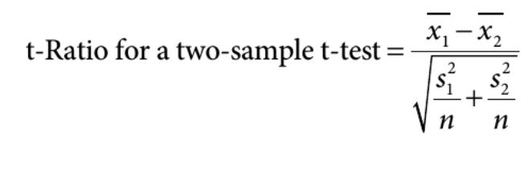
Example: The t-test
We use t-tests to compare two dependent or independent samples.
There are different types of t-tests.
For example, the formula for the Welch t-test looks like this:
👉

Slide 22
Example: The t-test
To compute the t-value, we need:
the means for both groups,
the standard deviations, and
the sample sizes.

Slide 23
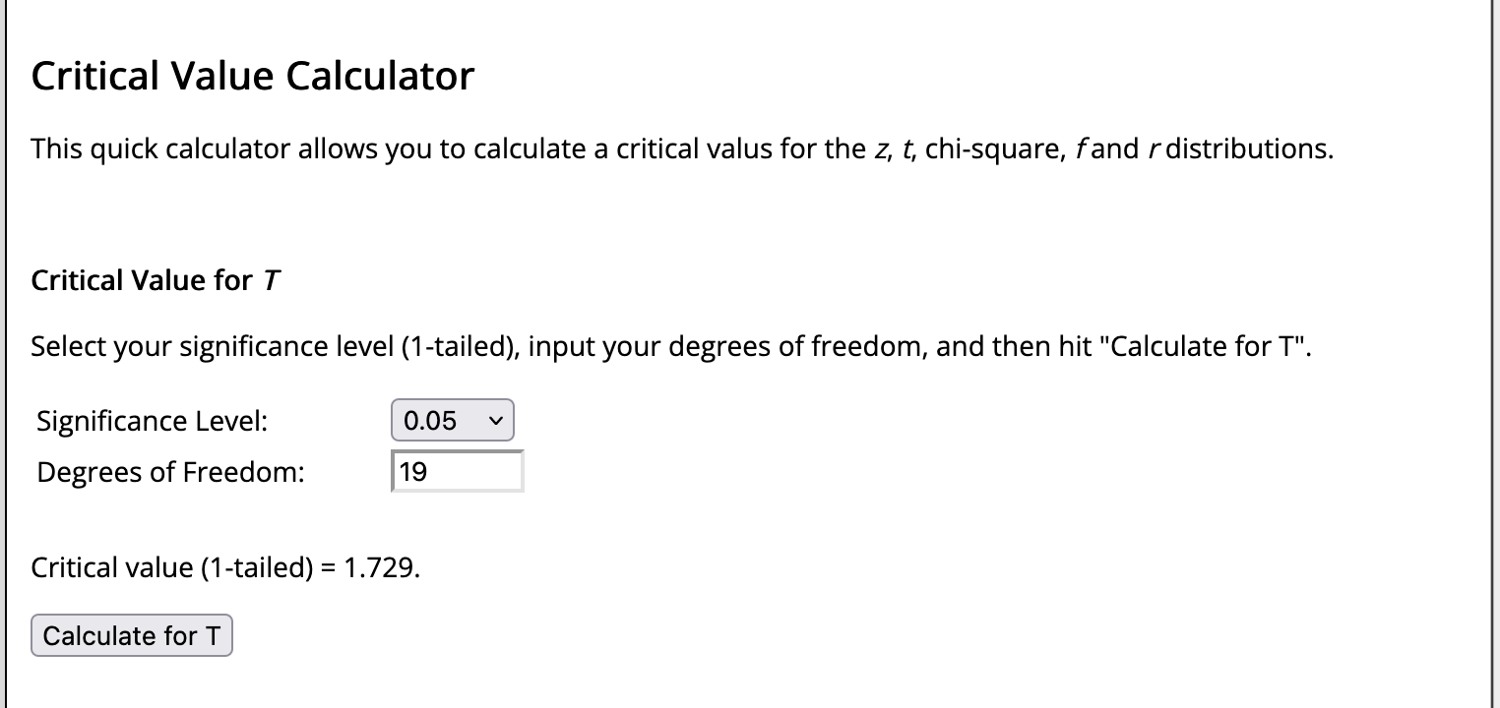
Use the t-distribution to check how probable your t-value is.
We will do with R in the handout, but there online calculators if you want to check values quickly.
For directional test (one-tailed), and df = 19, t₉₅ = 1.729.
t-values above 1.729 are more incompatible with the null hypotheses: more extreme values, in the tails.
👉
Notes:
If the null hypothesis is true (that there is no difference between UG and PG scores on the language exam), then a t-value below 2.09 is very improbable. We can reject the H₀.

Slide 24
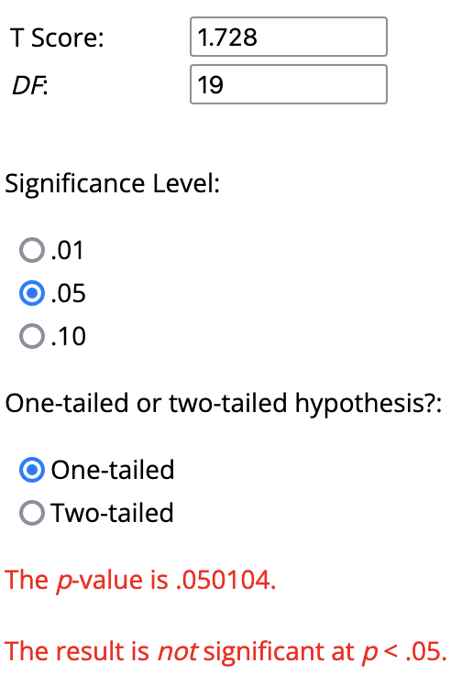
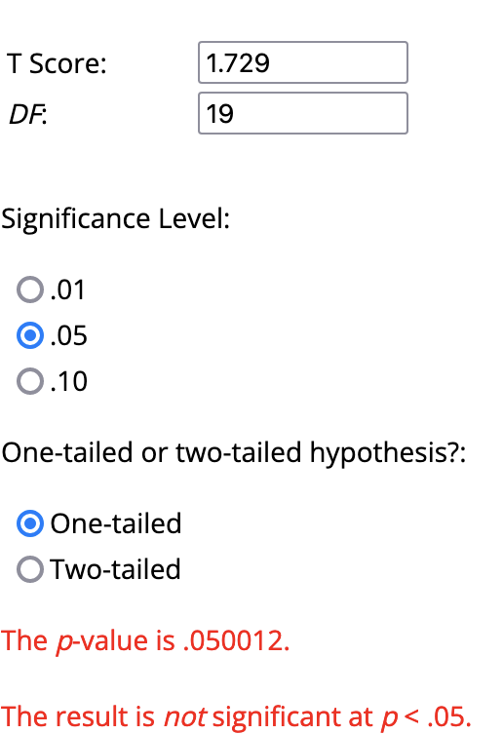
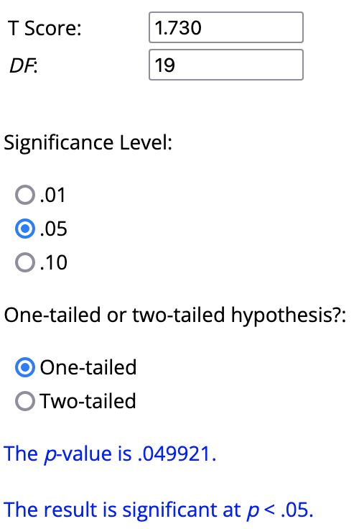
Compare t = 1.728, 1.729, 1.730
👉
👉
👉
With df = 19, any t-value > 1.729 is very improbable (less than 5% chance) if the null hypothesis is true.
Any t-value above the 1.729 is incompatible with the null hypothesis being true (if df = 19), so we reject the null hypothesis.
Notes:
If the null hypothesis is true (that there is no difference between UG and PG scores on the language exam), then a t-value below 2.09 is very improbable. We can reject the H₀.

Slide 25
Our earlier example
Sample effect size (raw): M_{diff} = 32.25
Standardized effect size: Cohen’s d = 1.96
Welch Two Sample t-test
t = 13.863, df = 186.55, p-value < 2.2e-16
95 percent confidence interval:
27.66306 36.84265
sample estimates:
mean of x mean of y
65.45040 33.19754
p = 0.00000000000000022

Slide 26
Let’s report our results
We need to report
either the two sample means M₁ and M₂ (UG and PG scores) or the mean difference (M_{diff}),
the SDs associated with two means, and
the 95% CI.
Ideally also a standardized effect size like Cohen’s d.
These tells us something about the practical significance our results.

Slide 27
Let’s report our results
In addition, we report the results of statistical significance.
Here, we report:
the t-value,
the degrees of freedom,
the p-value.
PS: p-values should be reported precisely (p = .234), except when they are lower than p < 0.01 or p < 0.001, respectively.

Slide 28
A possible report
“In the language exam, the mean score for undergraduate students was 65.45 (SD = 14.27) and the mean score for postgraduate students 36.84 (SD = 18.38). This difference represents a large effect, Cohen’s d = 1.96, 95% [1.62, 2.30].
A Welch t–test further showed that difference between undergraduate and postgraduate performance was statistically significant, t(187) = 13.86, p < .001.”

Slide 29
Questions?

Slide 30
Quantitative Research Methods
March 13, 2023
Professor Patrick Rebuschat
p.rebuschat@lancaster.ac.uk
Notes:
Section title slide.

Slide 31
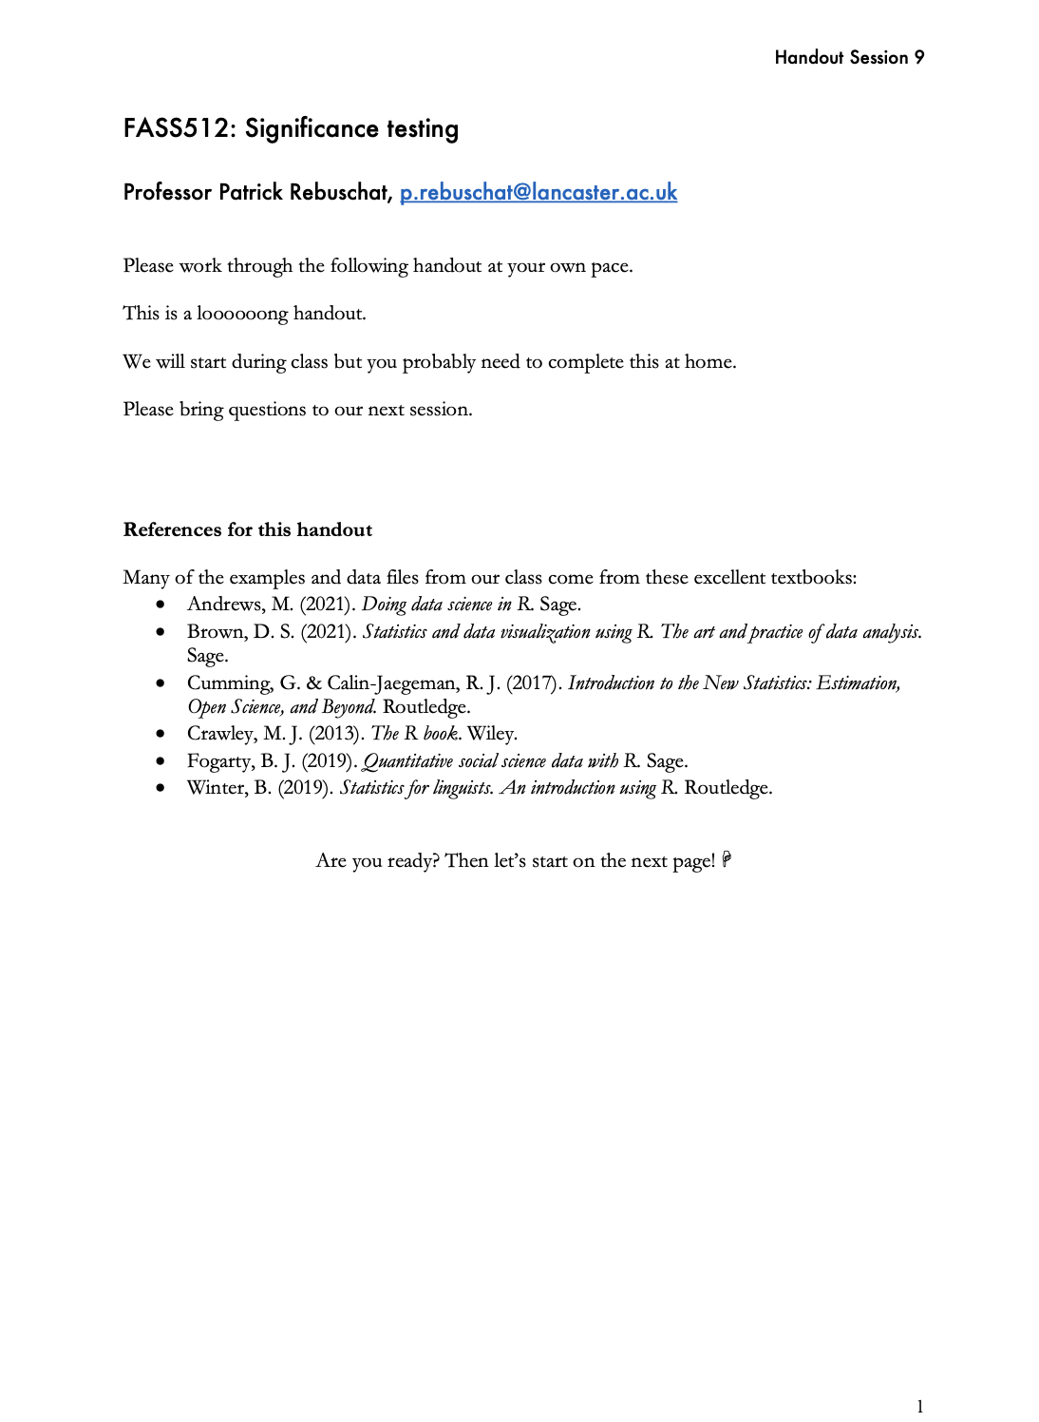
Today
Please work through the following handout at your own pace.
This is a loooooong handout.
We will start during class but you probably need to complete this at home.
Please bring questions to our next session.

Slide 32
Assumptions underlying most statistic tests
Data are randomly sampled from the population.
Data are independent.
Data are normally distributed.
Equal variances: The groups being compared have similar variances.
If our data violates these assumptions, we need to select alternative statistical tests.

Slide 33
Choosing the right statistical test
Selecting an appropriate significance test depends on four basic questions:
What kind of data is involved, continuous or categorical?
How many groups are being compared?
Are the group variances approximately equal?
Are the groups independent of one another?

Slide 34
Checking for normality
Two basic ways:
Visual inspection (with graphs) – quick but imprecise
Statistical test for normality
I recommend you do both – it’s part of exploring your data set before running inferential statistics.

Slide 35
Visual inspection for normality
We have used histograms for this before.

Slide 36
QQ-plots
This plots the quantiles of the observed data variable against the quantiles that we would expect if the data followed a normal distribution.
The observed data: Represented as white bubbles.
The expected data: A diagonal straight line
If the data distribution is approximately normal, then we expect the data points to sit more or less on top of the straight diagonal line; any deviation from it should be minor.

Slide 37
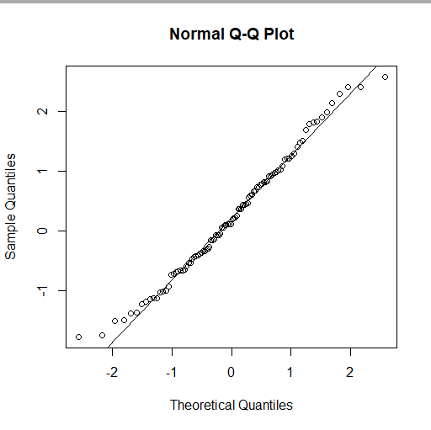
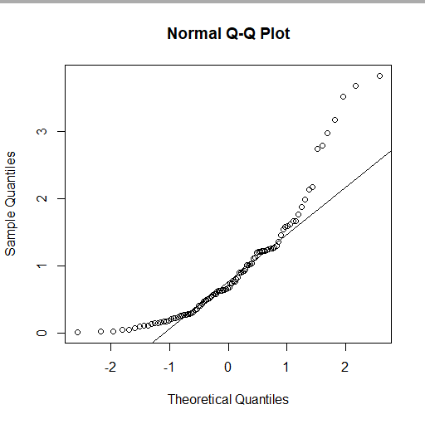
QQ-plots
Data drawn from non-normal distribution (Gamma distribution).
Data drawn from normal distribution.

Slide 38
Statistical test for normality
There are several tests that allow us to directly test whether our population data are likely to be normally distributed.
The Shapiro-Wilk’s test is widely recommended for normality test.
You will try this out in the handout.

Slide 39
Parametric vs non-parametric tests
Most statistic tests are normally-distributed data. These are called parametric tests.
If your data is not normally distributed, you can use non-parametric tests. These do not make any assumptions about the distributions that the statistics of interest follow.
In the handout, I will mention both types of test.

Slide 40
Variances
When using tests to check if different data sets have equal variances, we are actually trying to figure out if the population-level variances of the two groups are equal.
So it is not as easy as just saying that the variance of sample 1 is larger or smaller than the variance of sample 2.

Slide 41
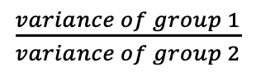
Variances
Classic procedure: F-ratio
The more this ratio deviates from 1, the stronger the evidence for unequal population variances.
To test more than two groups, we can use Bartlett’s test (for normally distributed data) or Levene’s test (for data that is not normally distributed).
$\frac{variance of group 1}{variance of group 2}$

Slide 42
Significance testing for continuous data
Tests for two groups: t-tests and related
Tests for more than two groups: ANOVA and related
In the handout, you will practice how to use the R to run different types of tests and what information to report.

Slide 43
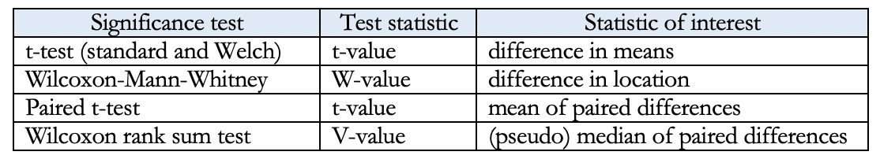
Reporting the results
When reporting the results, we need to report (at least) the following:
the “statistic of interest” (your measures of effect size) and its 95% confidence interval,
the test statistic (the results of the significance test)

Slide 44
Information to report
Example: t-test
Test statistic: t-value
degrees of freedom
p-value
Example: ANOVA
Test statistic: F-value
degrees of freedom (between and within)
p-value
We could report the result of the significance test as follows, following APA style. “An independent samples t-test showed that the difference betweeen groups was not significant, t(198) = -0.80019, p-value = 0.4246.” (The degrees of freedom are in the parentheses.)
Note: APA guidelines say we can round p-values to two or three decimals. Here, the actual value was p = .2123, so I rounded this to p = .212.
A note on scientific notation and funny-looking p-values
When working with R, as we saw with an example earlier, you may sometimes get a very funny-looking p-value like the one below.

Slide 45
Example of how you might write-up a t-test result
“The mean score on language exam 1 was 65.45 (SD = 14.27) for undergraduates and 33.20 (SD = 18.38) for postgraduates. Cohen’s d is 1.56, 95% CI [1.62, 2.30], which represents a large effect size (Cohen, 1988). An independent-samples t-test further showed that this difference between groups is significant, t(198) = 13.863, p-value < .001. That is, undergraduate students significantly outperformed their postgraduate counterparts on the first language exam.”

Slide 46
Example of how you might write-up an ANOVA test result
“The mean score on the maths exam was 55.97 (SD = 11.21) for language group A, M = 60.24 (SD = 20.28) for language group B, and M = 81.89 (SD = 20.24) for language group C. Our calculation of Cohen’s d to measure the difference between the three means revealed a large effect, d = 1.553. A one-way ANOVA demonstrated that the effect of native language on maths scores was significant, F(2, 197) = 40.23, p < .001. Post-doc comparisons using Tukey’s HSD test further revealed a significant difference between language group A and C, M_{diff} = 25.92, p < .001, and between language group B and C, M_{diff} = 25.92, p < .001. The difference between language groups A and B was not significant, M_{diff} = 4.27, p = .374. In other words, speakers of language C clearly outperformed the speakers of languages A and B in the maths exam.”

Slide 47
Our data: language exams
Simulated data, N = 200
Variables:
Our participants’ native languages three levels: Language A, Language B, Language C;
The level of study of our participants, two levels: undergraduate or postgraduate;
The scores of our participants on three foreign language exams, which our participants took in term 1, term 2, and term 3 respectively;
Theor scores on a maths exam.

Slide 48
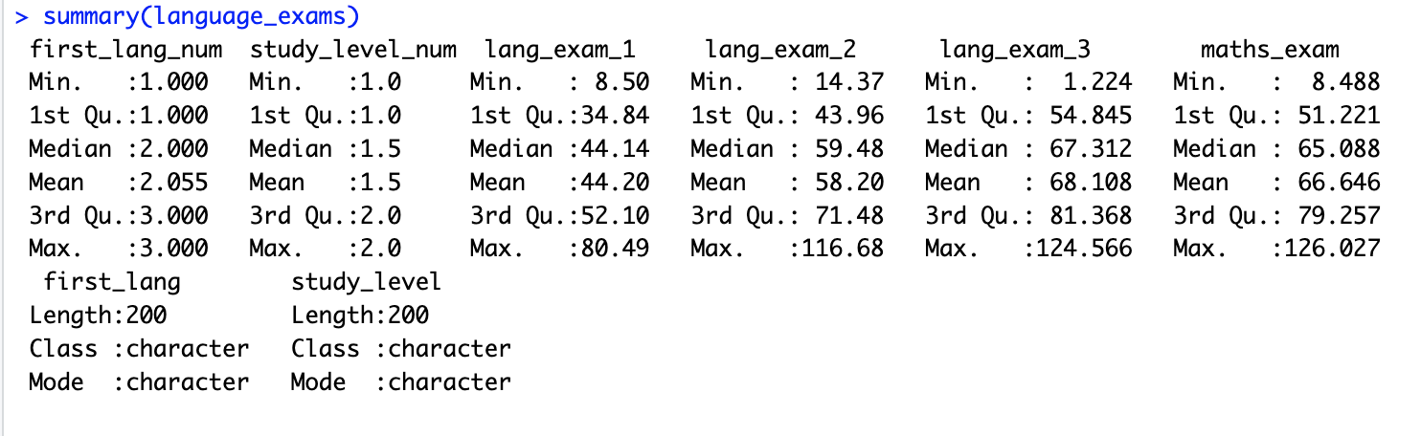
Our data: language exams

Slide 49
Quantitative Research Methods
March 13, 2023
Professor Patrick Rebuschat
p.rebuschat@lancaster.ac.uk
Notes:
Section title slide.

Slide 50
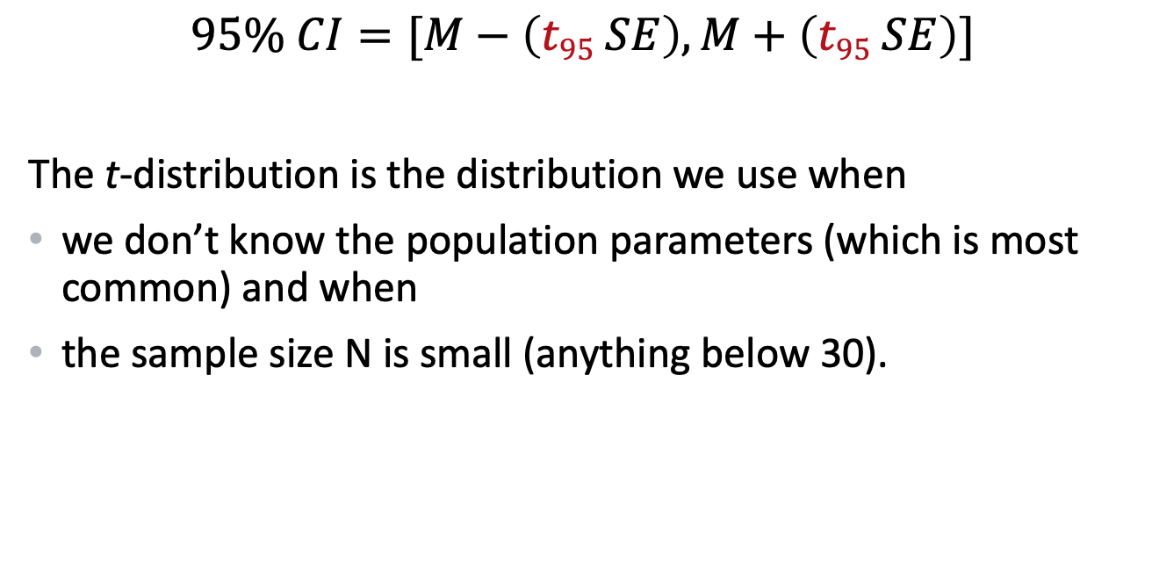
Calculating the 95% CI: When we do NOT know σ and when the sample size is small
$$95\% CI=[M−\left(t95 SE\right), M+\left(t95 SE\right)]$$
The t-distribution is the distribution we use when
we don’t know the population parameters (which is most common) and when
the sample size N is small (anything below 30).
Notes:
95% CI [M – 1.96 x σ/ SQRT(N), M + 1.96 x σ / SQRT(N)] Note: 1.96 from the z-distribution, 95% is always 1.96. [Explain where the 1.96 comes from]

